Slide 1
Advance Function

Slide 2
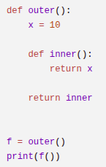
Closure in Python
A closure is a function that remembers variables from its outer scope even after the outer function has finished execution.
A closure is a function object that remembers values from its enclosing (lexical) scope even when that scope is no longer active.
Python implements closures using cell objects that store free variables referenced by nested functions.

Slide 3
Why is this closure?
Because after outer() finished execution x should normally disappear, but f() still remembers the value of x that remembered state is called a closure.

Slide 4
What Actually Happens in Memory?
Python uses:
Stack Frames
Heap Objects
Cell Objects (for closures)
A cell object is a small container object that holds a reference to a variable used in a closure.
It exists so that multiple function can share the same variable.
The variable can survive after the outer function finishes.

Slide 5
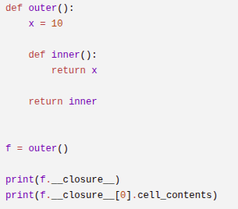
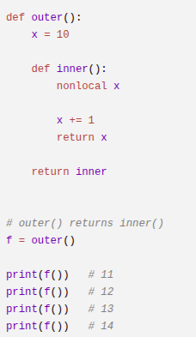

Slide 6
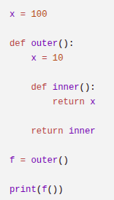
Lexical (enclosing) Scope
Lexical Scope means a function resolves variables according to where the function is defined in the source code, not where it is called from during execution.
inner() can access x because x belongs to its enclosing scope. This is called Lexical Scoping.

Slide 7
Higher Order Functions (HOF)
A Higher Order Function is a function that:
  1. Takes another function as an argument
  OR
  2. Returns a function
  OR
  3. Both
  Why is this possible?

Slide 8
Because functions in Python are First-Class Objects.
  Meaning:
    Functions can be:
    Stored in variables
    Passed as arguments
    Returned from functions
    Stored inside data structures
    Have identity, type and memory address

Slide 9
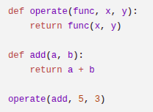
Passing Function
You are NOT passing code.
You are passing a reference to a function object in memory.

Slide 10
Why HOF Exists
Abstraction
  Separate what to do from how to apply it.
Reusability.
  Write generic logic once
Behavior Parameterization.
  Instead of passing data, pass behavior.

Slide 11
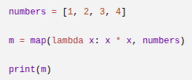
Lazy Evaluation Using map()
Python creates a map object.
It stores:
Function reference
Iterable reference
But it does not calculate anything.
Only when forced: list(m).

Slide 12
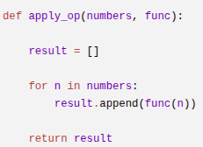
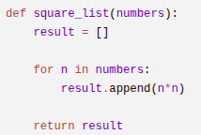

What makes HOF powerful?
HOF is not about map(), map() is just an example.
The real idea is instead of writing fixed logic you pass logic as a parameter.

Slide 13
Iterable
An iterable is an object capable of returning its members one at a time.
In simple words:
An iterable is any object that can be used inside a: for loop
  list
  tuple
  string
  set
  dictionary
  range

Slide 14

How Does Python Know It Is Iterable?
Because internally it implements: __iter__()

Slide 15
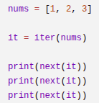
Iterator
An iterator is an object that: Remembers current position
Produces one value at a time
Implements __next__()
Iterable: Collection
Iterator: Producer

Slide 16
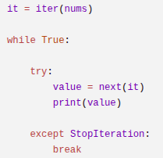


Slide 17
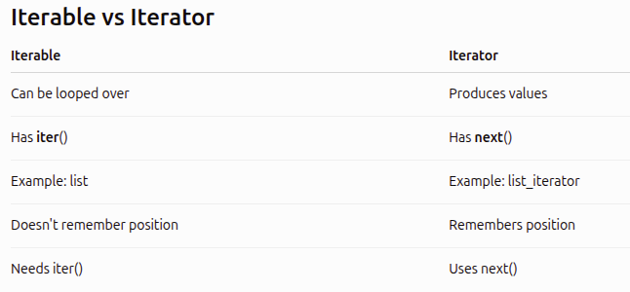

Slide 18
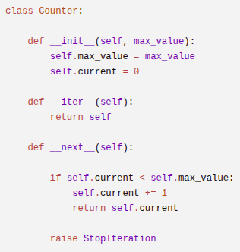
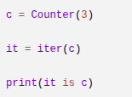

Custom Iterator
Python allows us to create our own iterators.
Think of __iter__() as answering this question:
"If someone wants to iterate (loop) over me, which iterator should I use?"
I am already an iterator. Use me.

Slide 19

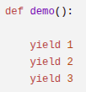
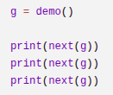
Generator
Generator is a special type of iterator created using: yield
Generator automatically provides: __iter__() and __next__() no need to write them manually.
Normal function
Return everything together
Generator function
Produces values one at a time.

Slide 20
What Does yield actually mean?
Think → yield = pause + return value
Unlike → return which terminates the function.
Yield → pauses execution.
Why Generators are powerful?

Slide 21

range(100000000000)
A list would consume huge memory.
Generator.
Stores only one value at a time.

Slide 22


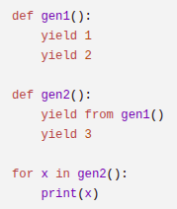
yield from
Used to delegate work to another generator.

Slide 23
